Slide 1
Codes in movies

Slide 2
Swordfish
A huge black ops fund lies waiting to be stolen. Can a computer expert liberate the money in time to save his daughter from the bad guys? And who are the bad guys anyway?

Slide 3
Windtalkers
Only a few can still speak or translate the native language of the Navajo, making it an ideal medium for radio communications on the battlefield. Security through obscurity has never been more exciting.

Slide 4
Mercury Rising
What would the government do to protect its newest cipher from a boy whose ASD brings the ability to crack it? And what will Bruce Willis do to protect him?

Slide 5
U-571
The capture of a German “Naval Enigma" machine would help the Allied forces to track German U-Boats. In real life it was the British Navy that accomplished the feat, but we will allow our Five Eyes partners across the Atlantic to claim the credit, just for the duration of this movie.

Slide 6
From Russia with Love
SPECTRE is planning to steal a Russian encryption machine, threatening to destabilise the fragile Cold War peace. For Bond to upset their plans he will have to fight classic Red Grant and the ruthless Rosa Klebb, a former KGB agent with poison-tipped shoes.

Slide 7
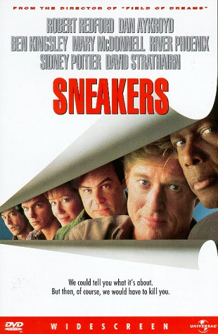
Sneakers
SETEC ASTRONOMY?

Slide 8
Enigma
When the U-boat fleet changes its Enigma protocols Bletchley Park find themselves unable to crack Nazi transmissions. With Britain dependent on the safe passage of Merchant Navy convoys it falls to code breakers Tom Jericho and Hester Wallace to break the code again.

Slide 9
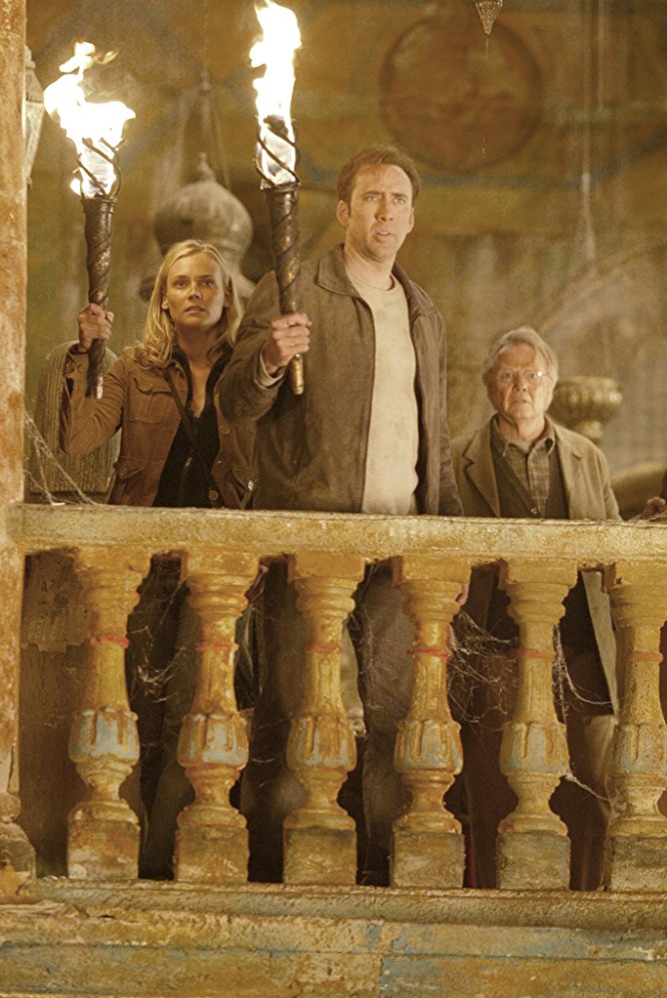
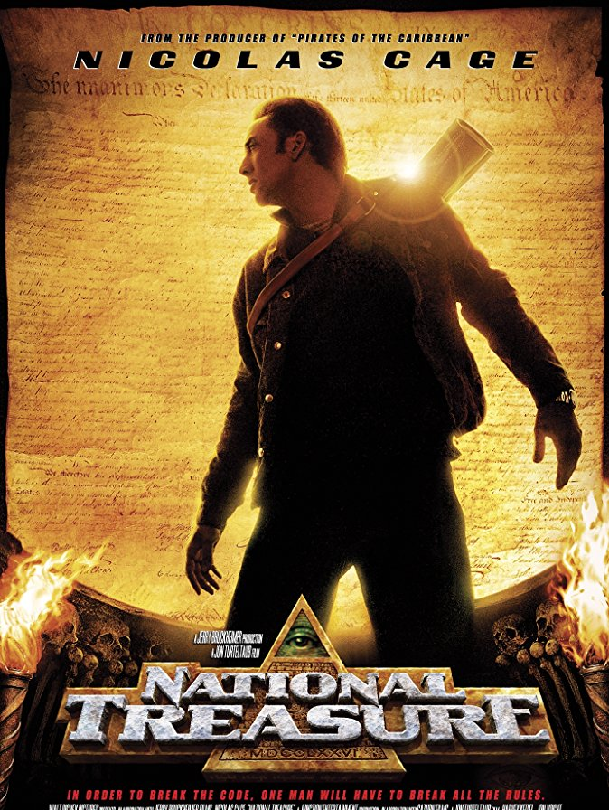
National Treasure
A historian races to find the legendary Templar Treasure before a team of mercenaries can find it. Secret messages hidden on important US historic artefacts lead to a nationwide hunt for the treasure and a quest to avoid imprisonment.

Slide 10
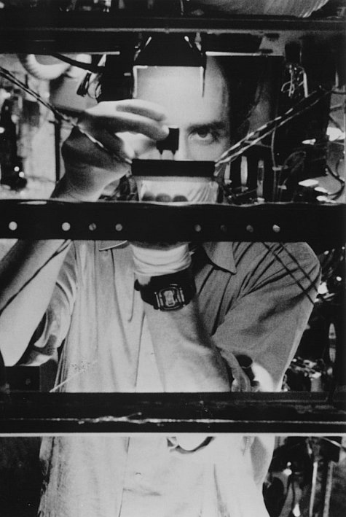
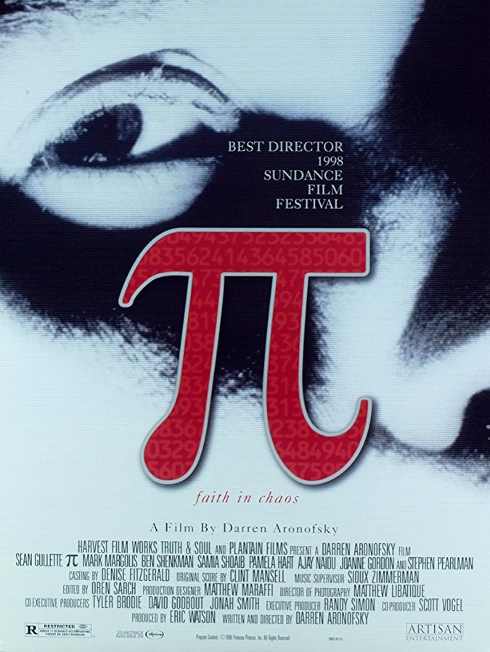
Pi
Does the transcendental number Pi contain within its digits a secret that will unlock the universal patterns found in nature? (Probably not, but its a neat idea, and a gripping movie!)

Slide 11
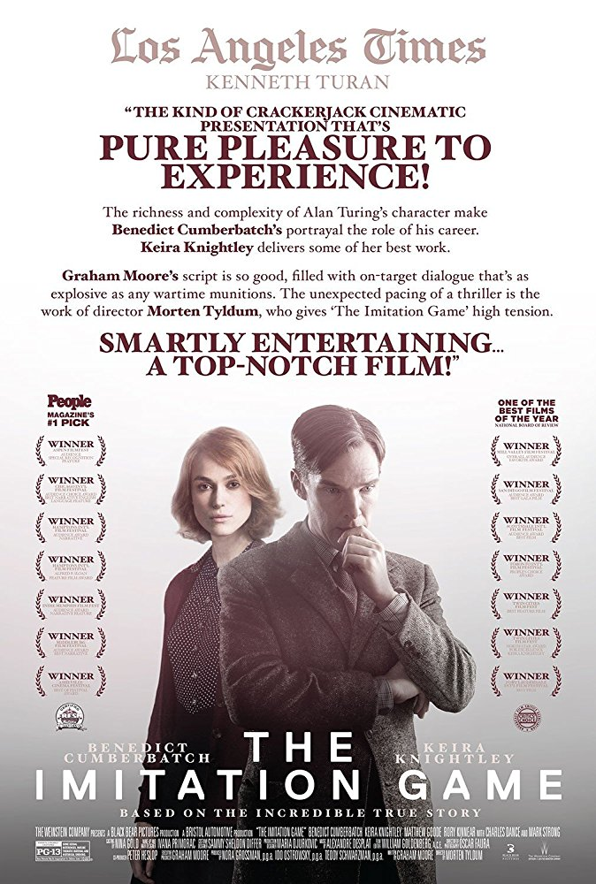
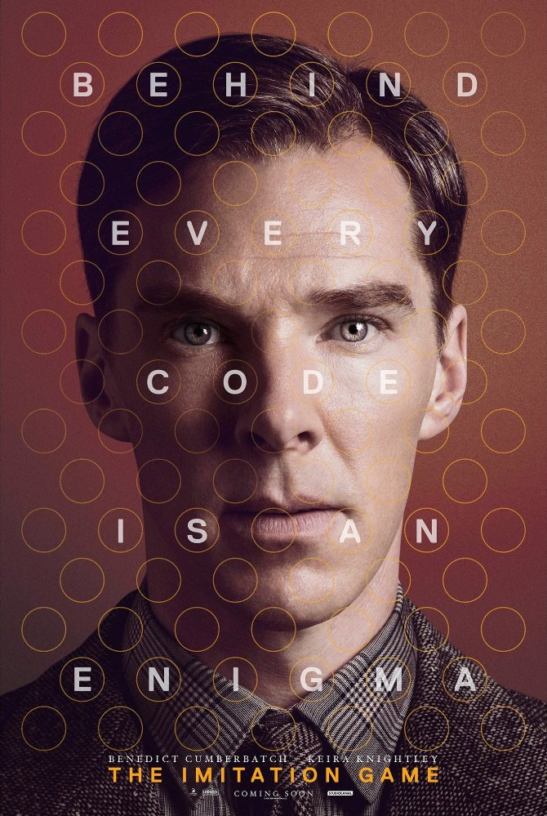
The Imitation Game
No mathematician did more to shape our lives in the 20th Century than Alan Turing. His work at Bletchley remained secret for decades, and this movie does a good job of explaining something of what he achieved and reminds of the suffering he underwent as a gay man in an age of repression.

